Slide 1
Contextual Bandit Approach Based Recommendation System for Personalized Web-based Services
Elif Özcan

Slide 2
Recommendation Systems
The main goal of a recommender system is to provide similar items to the user in which they are interested. Personalized recommender systems gradually learn about the interests of the users and provide them with items, which cater to their interests. The main three types of recommender systems are;
Content-based Recommender Systems,
Collaborative Filtering (CF) based Recommender Systems,
Hybrid Recommender Systems.

Slide 3
Related Works
Kiran R et al. (Kiran, Kumar, and Bhasker 2020) proposed Deep Learning-based Hybrid Recommender System (DNNRec) to improve the accuracy of the existing collaborative filtering systems using deep learning. This helps them to overcome Cold-start problem, i.e. for new users who have no history.
Yongfeng Qiana (Qian et al. 2019) proposed an Emotion-aware recommender system (EARS), which considers implicit and explicit feedback information mainly reviews, clicks and ratings but most importantly, the user’s emotions in the final purchasing of the product. This aims at improving the quality of the collaborative filtering recommender systems.
Guo et al. (Guo, Zhang, and Yorke- Smith 2015) developed a trust-based recommender model (Merge) that only includes the trusted users’ ratings for improving the accuracy which incorporates the ratings of trusted neighbors in providing recommendations. These approaches improve recommendation performance with the support of the social relationships in the network.

Slide 4

Exploration-Exploitation Dilemma
One of the problems that mentioned in the article is exploitation-exploration dilemma, where exploitation means recommending the optimal items to a user, based on the past behaviour and exploration means learning about the recation for new items’ for a particular user by recommending new items to that user.
Multi-armed bandit algorithms provide a solution to the exploration-exploitation dilemma.

Slide 5
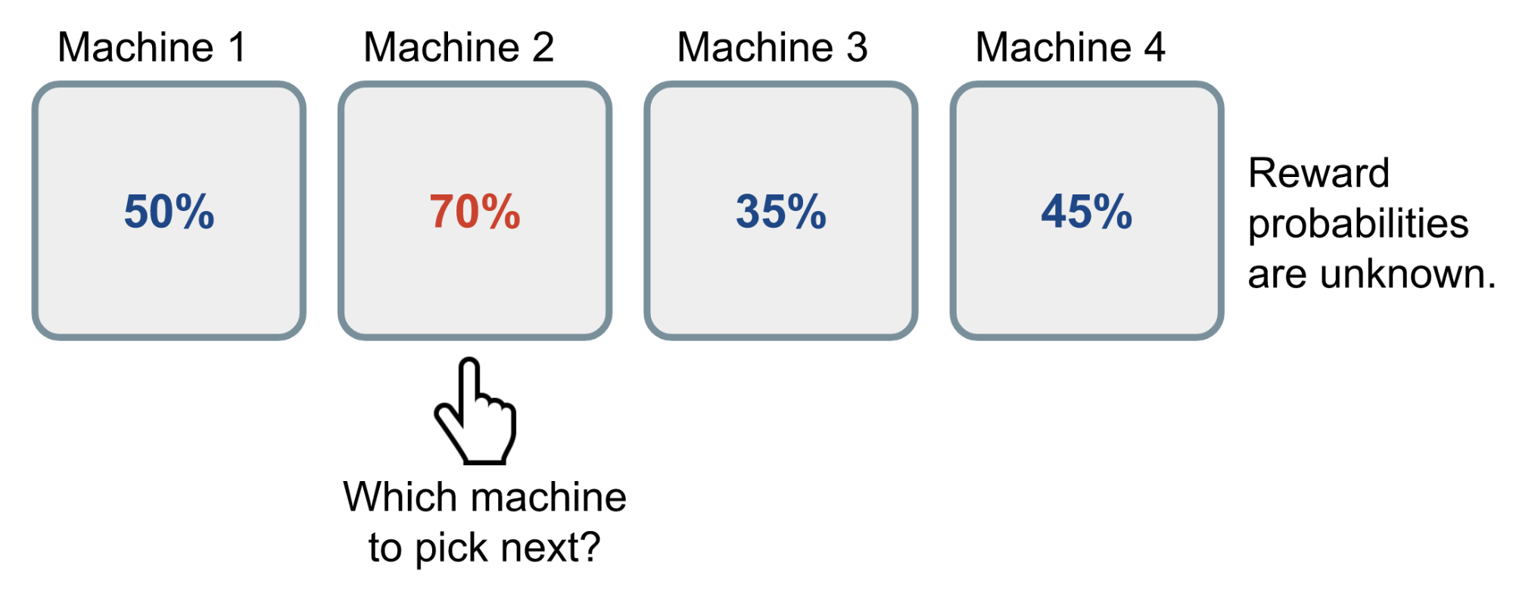
Multi-Armed Bandit Problem
The multi-armed bandit problem is a classic reinforcement learning example where we are given a slot machine with n arms which are called bandits with each arm having its own probability distribution of success. Pulling any one of the arms gives you a reward of either 1 for success, or 0 for failure. The manin goal is to pull the arms one-by-one in sequence such that we maximize our total reward collected in the long run.

Slide 6

Bandit Algorithms
There are many ways to solve MAB problem based on the exploration. Some of the bandit algorithms are:
ε-Greedy Algorithm: The ε-greedy algorithm takes the best action most of the time, but does random exploration occasionally. Because pure Greedy strategy has a very high risk of selecting a sub-optimal and then sticking with this selection.
Upper Confidence Bounds: Rather than performing exploration by simply selecting an arbitrary action, chosen with a probability that remains constant, the UCB algorithm changes its exploration-exploitation balance as it gathers more knowledge of the environment. Instead of fully randomness be optimistic about options with high uncertainty and thus to prefer actions for which we haven’t had a confident value estimation yet. Or in other words, we favor exploration of actions with a strong potential to have a optimal value.

Slide 7

Thompson Sampling: Instead of just selecting actions based on the current averages of the rewards received from actions Thompson Sampling algoritm builds up a probability model from the obtained rewards, and then samples from this to choose an action. the model also provides a level of confidence in this reward, and this confidence increases as more samples are collected.

Slide 8
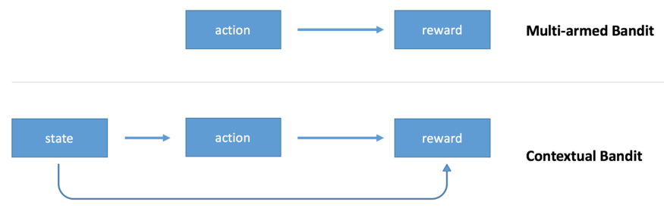
Contextual Bandits
The multi-armed bandit algorithm outputs an action but doesn’t use any information about the state of the environment (context). The algorithm observes a context, makes a decision, choosing one action from a number of alternative actions, and observes an outcome of that decision. An outcome defines a reward. The goal is to maximize average reward.
For example, if you use a multi-armed bandit to choose whether to display cat images or dog images to the user of your website, you’ll make the same random decision even if you know something about preferences of the user. The contextual bandit extends the model by making the decision conditional on the state of the environment. In short Contextual Bandit Algorithms are a combination of multi-armed bandits and user context.
For evaluating the performance of various contextual bandit algorithms, performance metrics such as Cumulated Regret and Click Through Rate Ratio (CTR Ratio) are commonly used.

Slide 9
Algorithms Used in the Article
LinUCB : The LinUCB algorithm evaluates the reward rate of each arms as a linear function with an assumption that the arms do not share features and are distinct from each other. Adapting this approach will be more beneficial for personalized recommendation because in recommendation systems such as news recommendation items are not compeletly distinct from each other. LinUCB is a way to apply UCB to the more general contextual bandits setting.
Hybrid LinUCB: For each arm is a linear function of shared and non-shared components.
CoLin: As compared to the Linear regret bandit algorithms, CoLin algorithm achieves an exceptional reduction of upper regret bound with high probability. CoLin incorporates collaborative preference learning so it can control the exploration-exploitation trade-off much better than other bandit algorithms and timely recognized the item popularity changes. However, CoLin algorithm has a limitation; it has high computational complexity because of the global matrix formation.

Slide 10
Conculusions
The paper presents a comparative analysis of existing personalized recommendation techniques such as LinUCB, Hybrid-LinUCB, and CoLin. Each algorithm is implemented on structurally different datasets, i.e. Synthetic, Yahoo FrontPage Today Module, LastFM, and MovieLens20M. After the implementation and execution of these algorithms on the above datasets, it has been observed that the CoLin outperforms Hybrid-LinUBC and LinUCB, reporting cumulated regret of 8.950 for LastFm and 60.34 for MovieLens20M.

Slide 11
References
https://towardsdatascience.com/recommender-systems-using-linucb-a-contextual-multi-armed-bandit-approach-35a6f0eb6c4
https://lilianweng.github.io/posts/2018-01-23-multi-armed-bandit/
https://towardsdatascience.com/multi-armed-bandits-part-1-b8d33ab80697
https://towardsdatascience.com/contextual-bandits-and-reinforcement-learning-6bdfeaece72a
https://towardsdatascience.com/solving-the-multi-armed-bandit-problem-b72de40db97c

